Slide 1
Abnormal Traffic

Slide 2
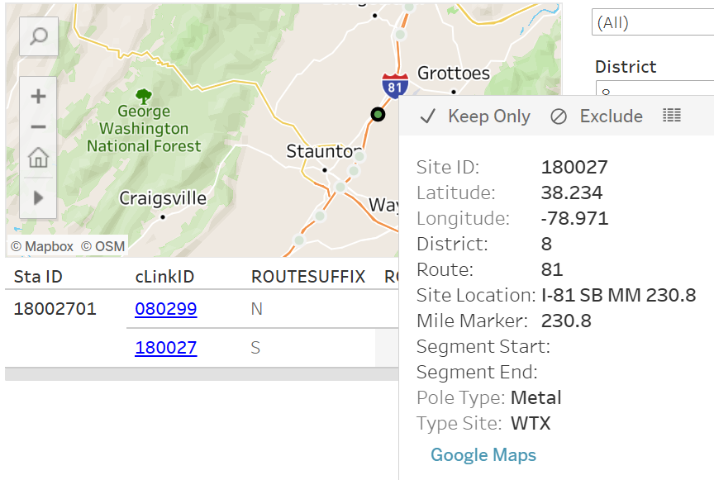

Slide 3
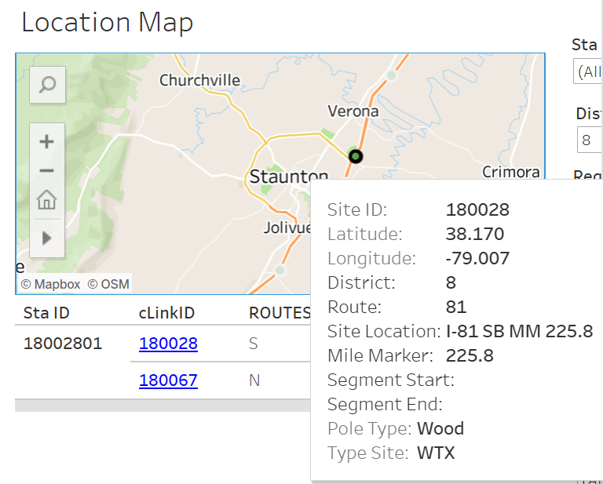

Slide 4
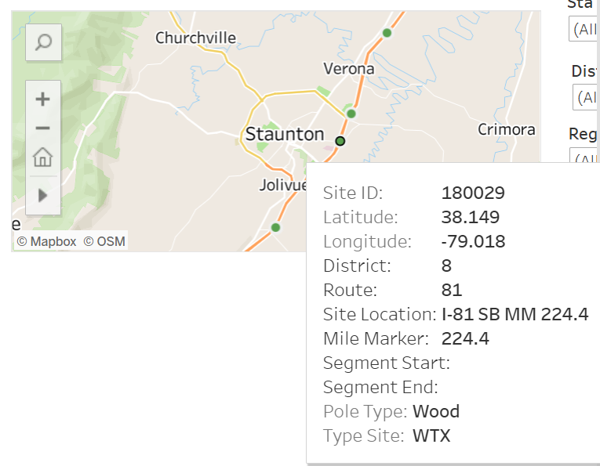

Slide 5
Questions for Chien-Lun
Mile markers for count stations 080250, 080298, 180029, 180031?

